Slide 1
Estimation of parameters

Slide 2
Statistical Inference
Statistical inference consists of methods by which one makes inferences or generalizations about a population.
Inferences are based strictly on information obtained from a random sample selected from the population.
Statistical inference may be divided into two major areas:
Estimation of Parameters
Testing of Hypotheses

Slide 3
Point Estimation
Point estimation of a population parameter provides as an estimate of a single value calculated from the sample that is likely to be close to the unknown parameter.

Slide 4
Interval estimation
Even the most efficient unbiased estimator is unlikely to estimate the population parameter exactly.
It is true that estimation accuracy increases with large samples, but there is still no reason we should expect a point estimate from a given sample to be exactly equal to the population parameter it is supposed to estimate.
There are many situations in which it is preferable to determine an interval within which we would expect to find the value of the parameter.
Such an interval is called an interval estimate.

Slide 5

Interval estimation
An interval estimate of a population parameter θ is an interval of the form ^{ˆ}θ_{L} < θ < ^{ˆ}θ_{U}.
for 0 < α < 1, we have a probability of 1−α of selecting a random sample that will produce an interval containing θ.
The fraction 1 − α is called the confidence coefficient or the degree of confidence, and the endpoints, ˆθL and ˆθU, are called the lower and upper confidence limits.
Thus, when α = 0.05, we have a 95% confidence interval, and when α = 0.01, we obtain a wider 99% confidence interval.
The wider the confidence interval is, the more confident we can be that the interval contains the unknown parameter.
Of course, it is better to be 95% confident that the average life of a certain television transistor is between 6 and 7 years than to be 99% confident that it is between 3 and 10 years.

Slide 6
Single Sample: Estimating the Mean
The sampling distribution of x̅ is centered at μ.
Thus, the sample mean x̅ will be used as a point estimate for the population mean μ.
σ²_{x̅} = σ²/n
If n is sufficiently large, we can establish a confidence interval for μ by considering the sampling distribution of x̅.
According to the Central Limit Theorem, the sampling distribution of x̅ to be approximately normally distributed with mean μ_{x̅} = μ and standard deviation σ_{x̅} = σ/√n.

Slide 7
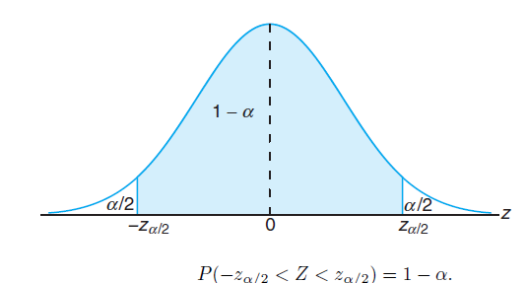




Single Sample: Estimating the Mean

Slide 8
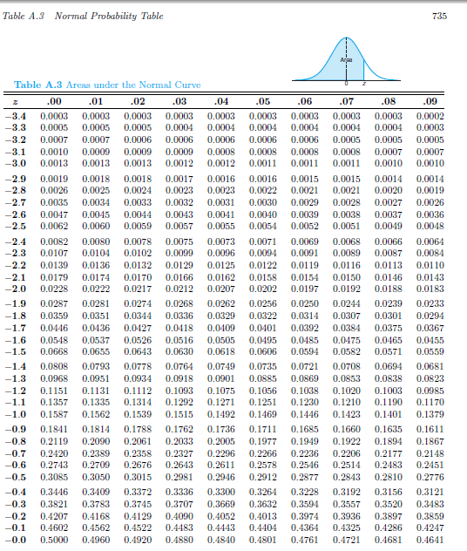

Slide 9


Slide 10
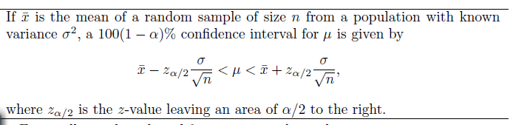
Confidence Interval when
Confidence Interval on μ, σ² Known

Slide 11

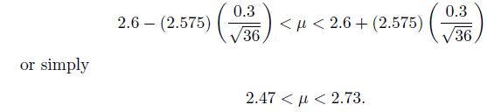
Example: The average zinc concentration recovered from a sample of measurements taken in 36 different locations in a river is found to be 2.6 grams per milliliter. Find the 95% and 99% confidence intervals for the mean zinc concentration in the river.Assume that the population standard deviation is 0.3 gram per milliliter.
Solution: The point estimate of μ is x̅ = 2.6.
z 0.025 = 1.96 (Table A.3). Hence, the 95% confidence interval is
To find a 99% confidence interval, z0.005 = 2.575, and the 99% confidence interval

Slide 12
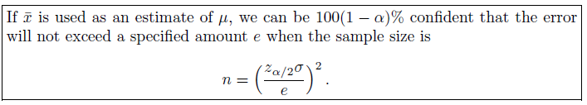

Slide 13
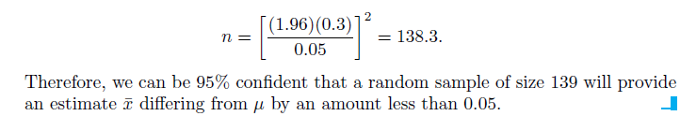
Example: How large a sample is required if we want to be 95% confident that our estimate of μ in previous example is off by less than 0.05?
Solution : The population standard deviation is σ = 0.3.

Slide 14
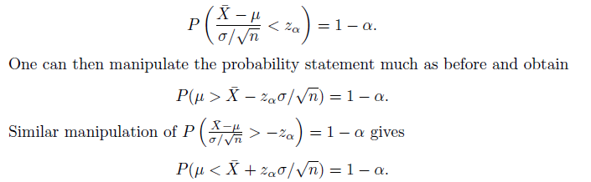
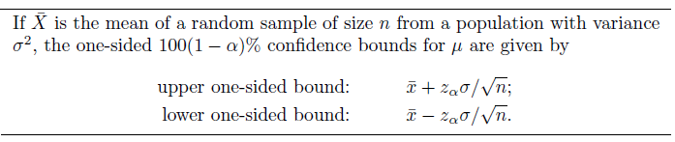
One-Sided Confidence Bounds

Slide 15
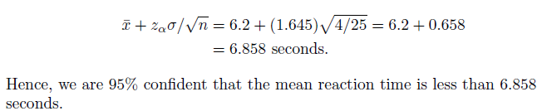
Example: In a psychological testing experiment, 25 subjects are selected randomly and their reaction time, in seconds, to a particular stimulus is measured. Past experience suggests that the variance in reaction times to these types of stimuli is 4 sec² and that the distribution of reaction times is approximately normal. The average time for the subjects is 6.2 seconds. Give an upper 95% bound for the mean reaction time.
Solution : The upper 95% bound is given

Slide 16




The Case of Unknown POPULATION STANDARD DEVIATION
If we have a random sample from a normal distribution, then the random variable has a Student t-distribution with n − 1 degrees of freedom. Here S is the sample standard deviation. In this situation, with σ unknown, T can be used to construct a confidence interval on μ.

Slide 17
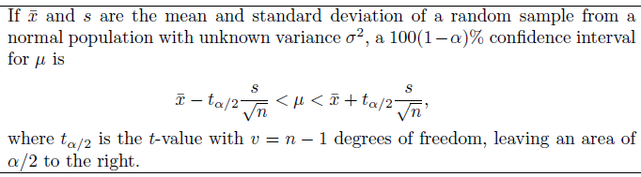
Confidence Interval when
Confidence Interval on μ, σ² unknown

Slide 18
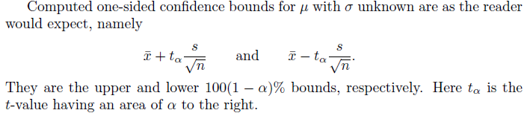
One-sided confidence interval

Slide 19
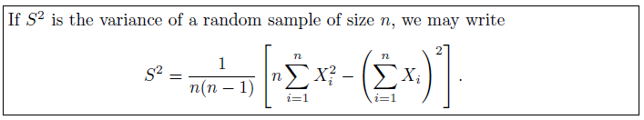
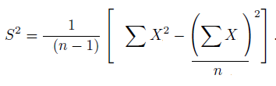
Unbiased Sample variance

Slide 20
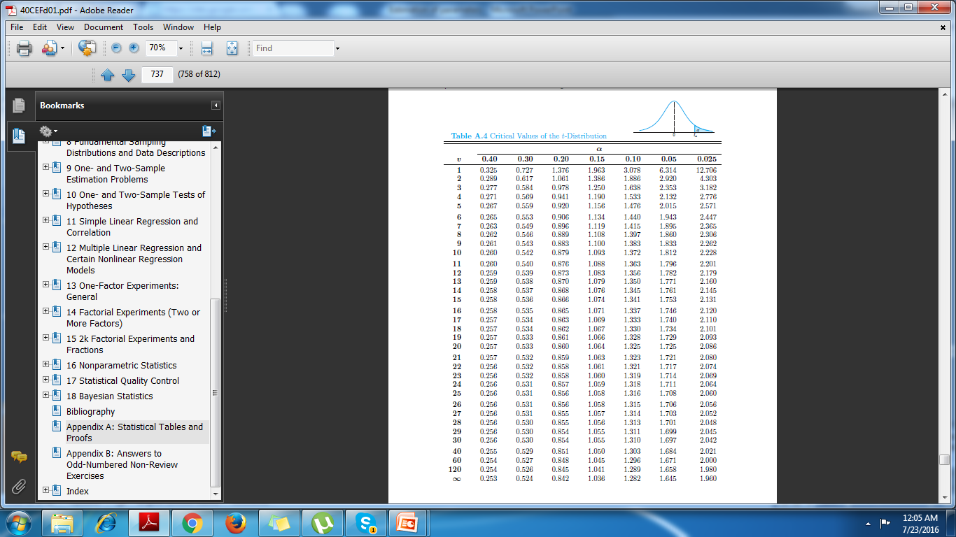

Slide 21
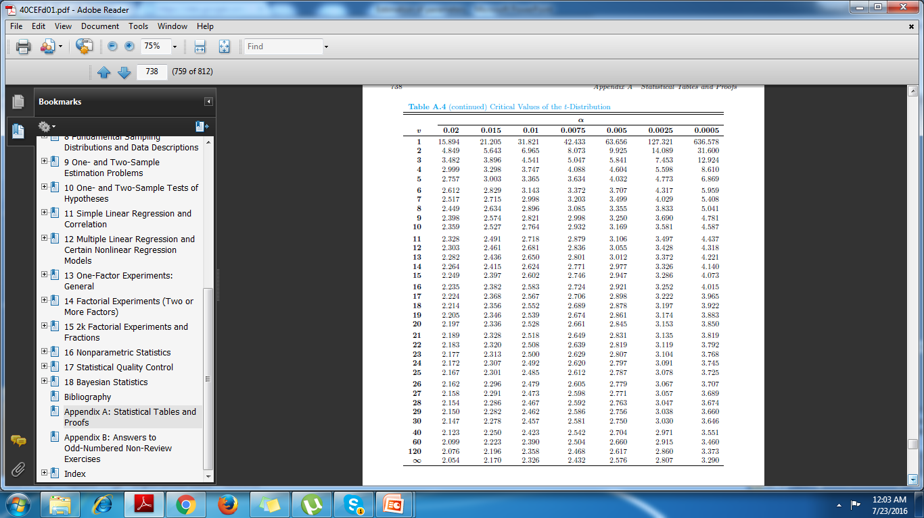

Slide 22
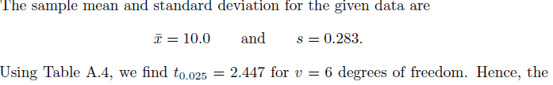
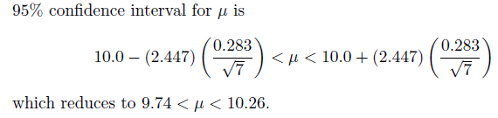
Example: The contents of seven similar containers of sulfuric acid are 9.8, 10.2, 10.4, 9.8, 10.0, 10.2, and 9.6 liters. Find a 95% confidence interval for the mean contents of all such containers, assuming an approximately normal distribution.
Solution:

Slide 23

Concept of a Large-Sample Confidence Interval
Often statisticians recommend that even when normality cannot be assumed, σ is unknown, and n ≥ 30, s can replace σ and the confidence interval

Slide 24
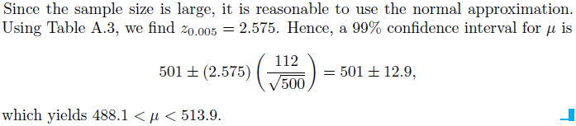
Example: Scholastic Aptitude Test (SAT) mathematics scores of a random sample of 500 high school seniors in the state of Texas are collected, and the sample mean and standard deviation are found to be 501 and 112, respectively. Find a 99% confidence interval on the mean SAT mathematics score for seniors in the state of Texas.
Solution:

Slide 25




Confidence Interval on μ, σ² Known

Slide 26




Confidence Interval on μ, σ² unknown and n<30

Slide 27




Confidence Interval on μ, σ² unknown and n≥30

Slide 28
Assignment
9.2
9.3
9.4
9.5
9.6
9.7
9.9
9.11
9.12
9.14

